Slide 1
Wasatch Wildlife
2018 - 2020
Jesse Eng, Katherine Layton, Charlie Smoot and Richard Thomas

Slide 2
Wildlife Data Summary
Data from Wildlife Insights – a non-profit organization that puts motion triggered cameras into the wilderness for identification of animals
Each data point is an observation of an animal species, location, date and time.

Slide 3
How does human urbanization affect wildlife in the Wasatch?

Slide 4
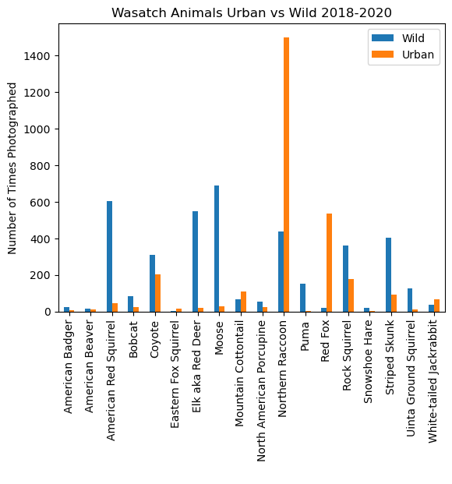
Urban vs Wild Data
Null hypothesis – There is no significant difference in animal frequencies between urban and wild settings.
T-test result – p value = .553
This is to say there is not a significant difference between urban and wild settings for animals overall.

Slide 5
Urban vs Wild Data
The following animals were the only observations photographed all 3 years in both wild and urban settings.
Animal | T-test p-value | Reject Null Hypothesis?
American Red Squirrel | 0.1470 | No
Elk | 0.0057 | Yes
Moose | 0.0860 | Yes
Striped Skunk | 0.1300 | No
Red Fox | 0.3550 | No
Northern Raccoon | 0.5100 | No
Mule Deer | 0.1500 | No
T-test at 90% confidence found Elk and Moose were significantly affected negatively by human infrastructure

Slide 6
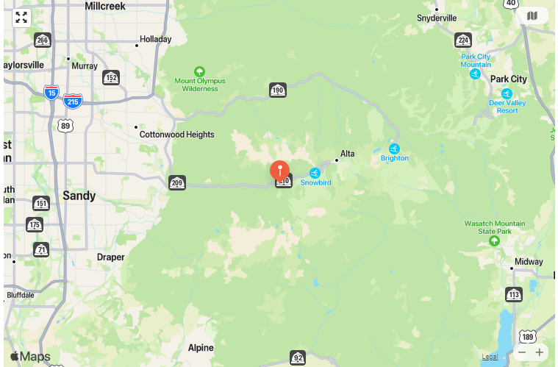
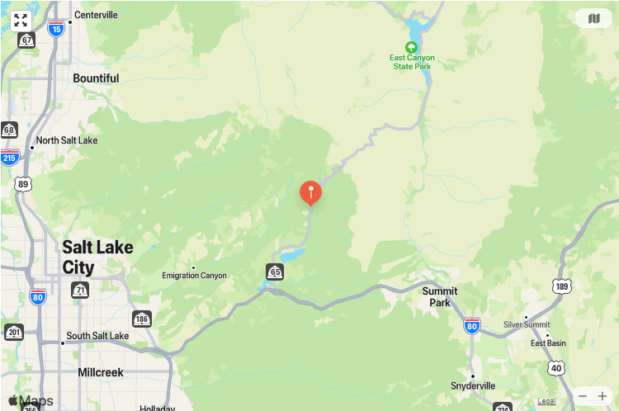
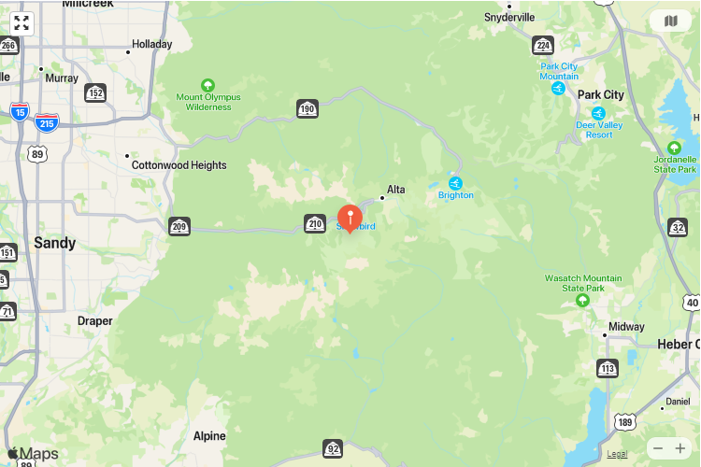
Observation Stations
d65901
These 3 locations had some of the most wildlife traffic present
d55071
d65909

Slide 7
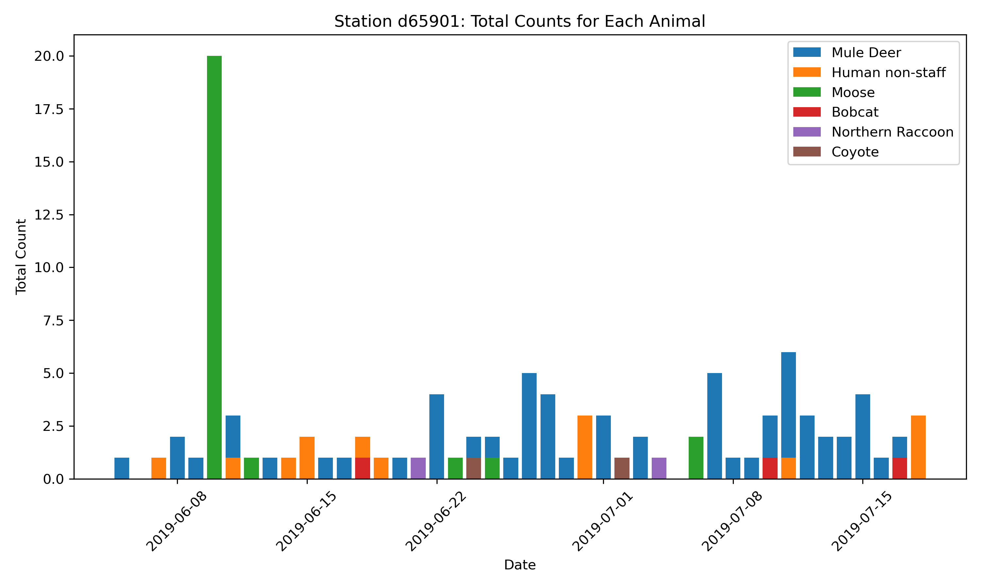
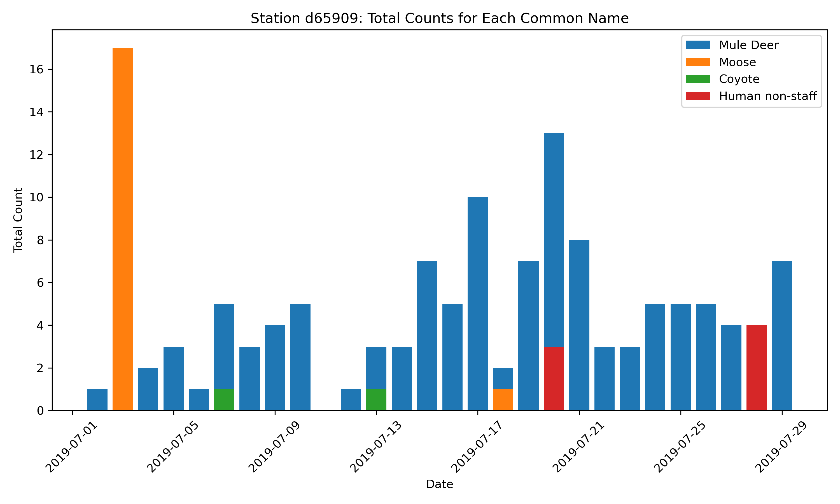
Human vs Wildlife correlation?
P-Value: 0.56
Null hypothesis: urbanization does affect wildlife
A 2 sample t-test was performed.
Null Hypothesis: there are fewer sightings of wildlife when humans are present.
As p-Value is greater than 0.05 then the data failed to reject the Null Hypothesis
P-Value: 0.56

Slide 8
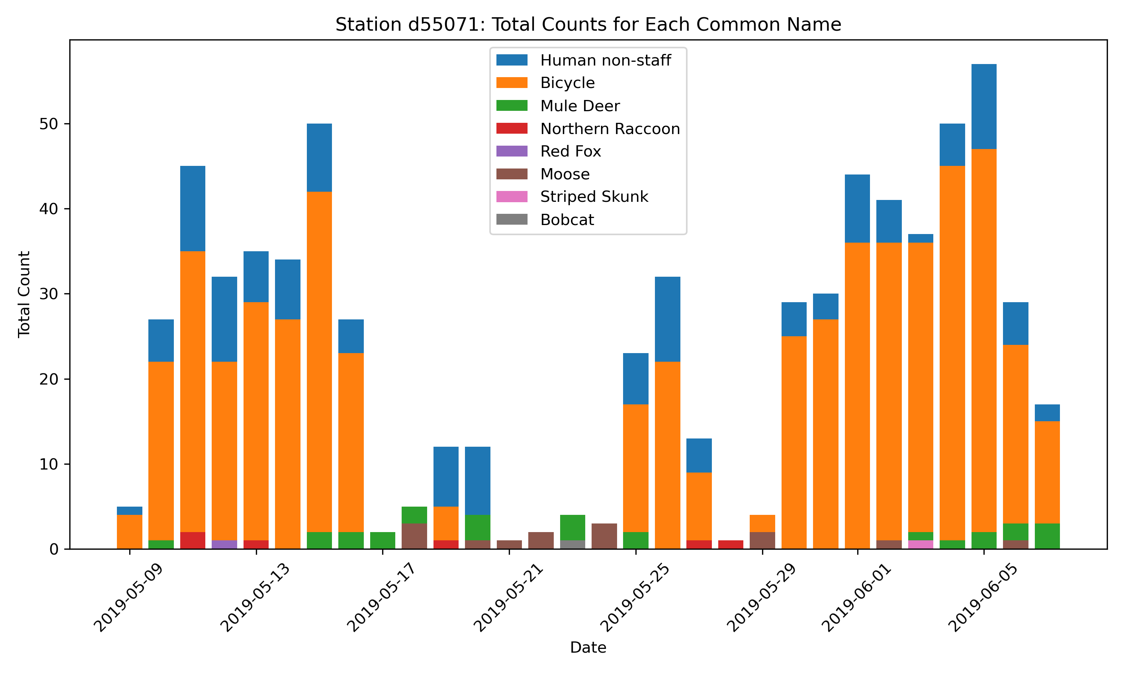
Human vs animal correlation?
The P value for this station (55071) is less than .05 so we reject the null hypothesis
P-Value: 0.016

Slide 9
How does weather affect wildlife in the Wasatch?

Slide 10
Weather Data Summary
Utilizing Open-Meteo API we collected historical weather data for each date that an animal was observed. This data included temperature, precipitation, weather type and sunrise/sunset data
We merged the wildlife and weather data using the date of observation.

Slide 11
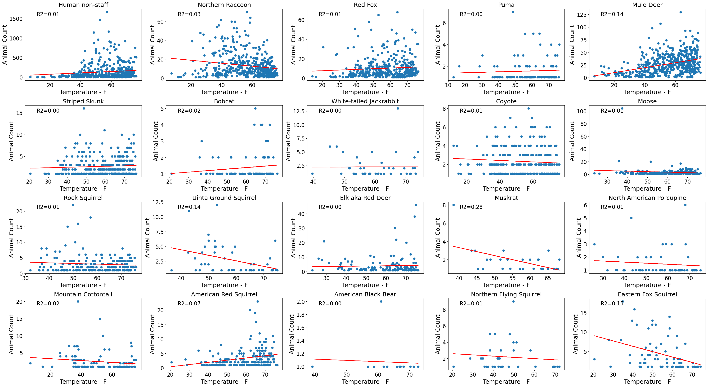

Temp vs Wildlife
Key Conclusions
Mule Deer
Highest R² of all observed animals
Humans
Human counts don’t increase significantly until ~40° F
Moose
Zero correlation to temperature
Black Bear
Predominantly not seen until ~50° F (hibernation?)

Slide 12
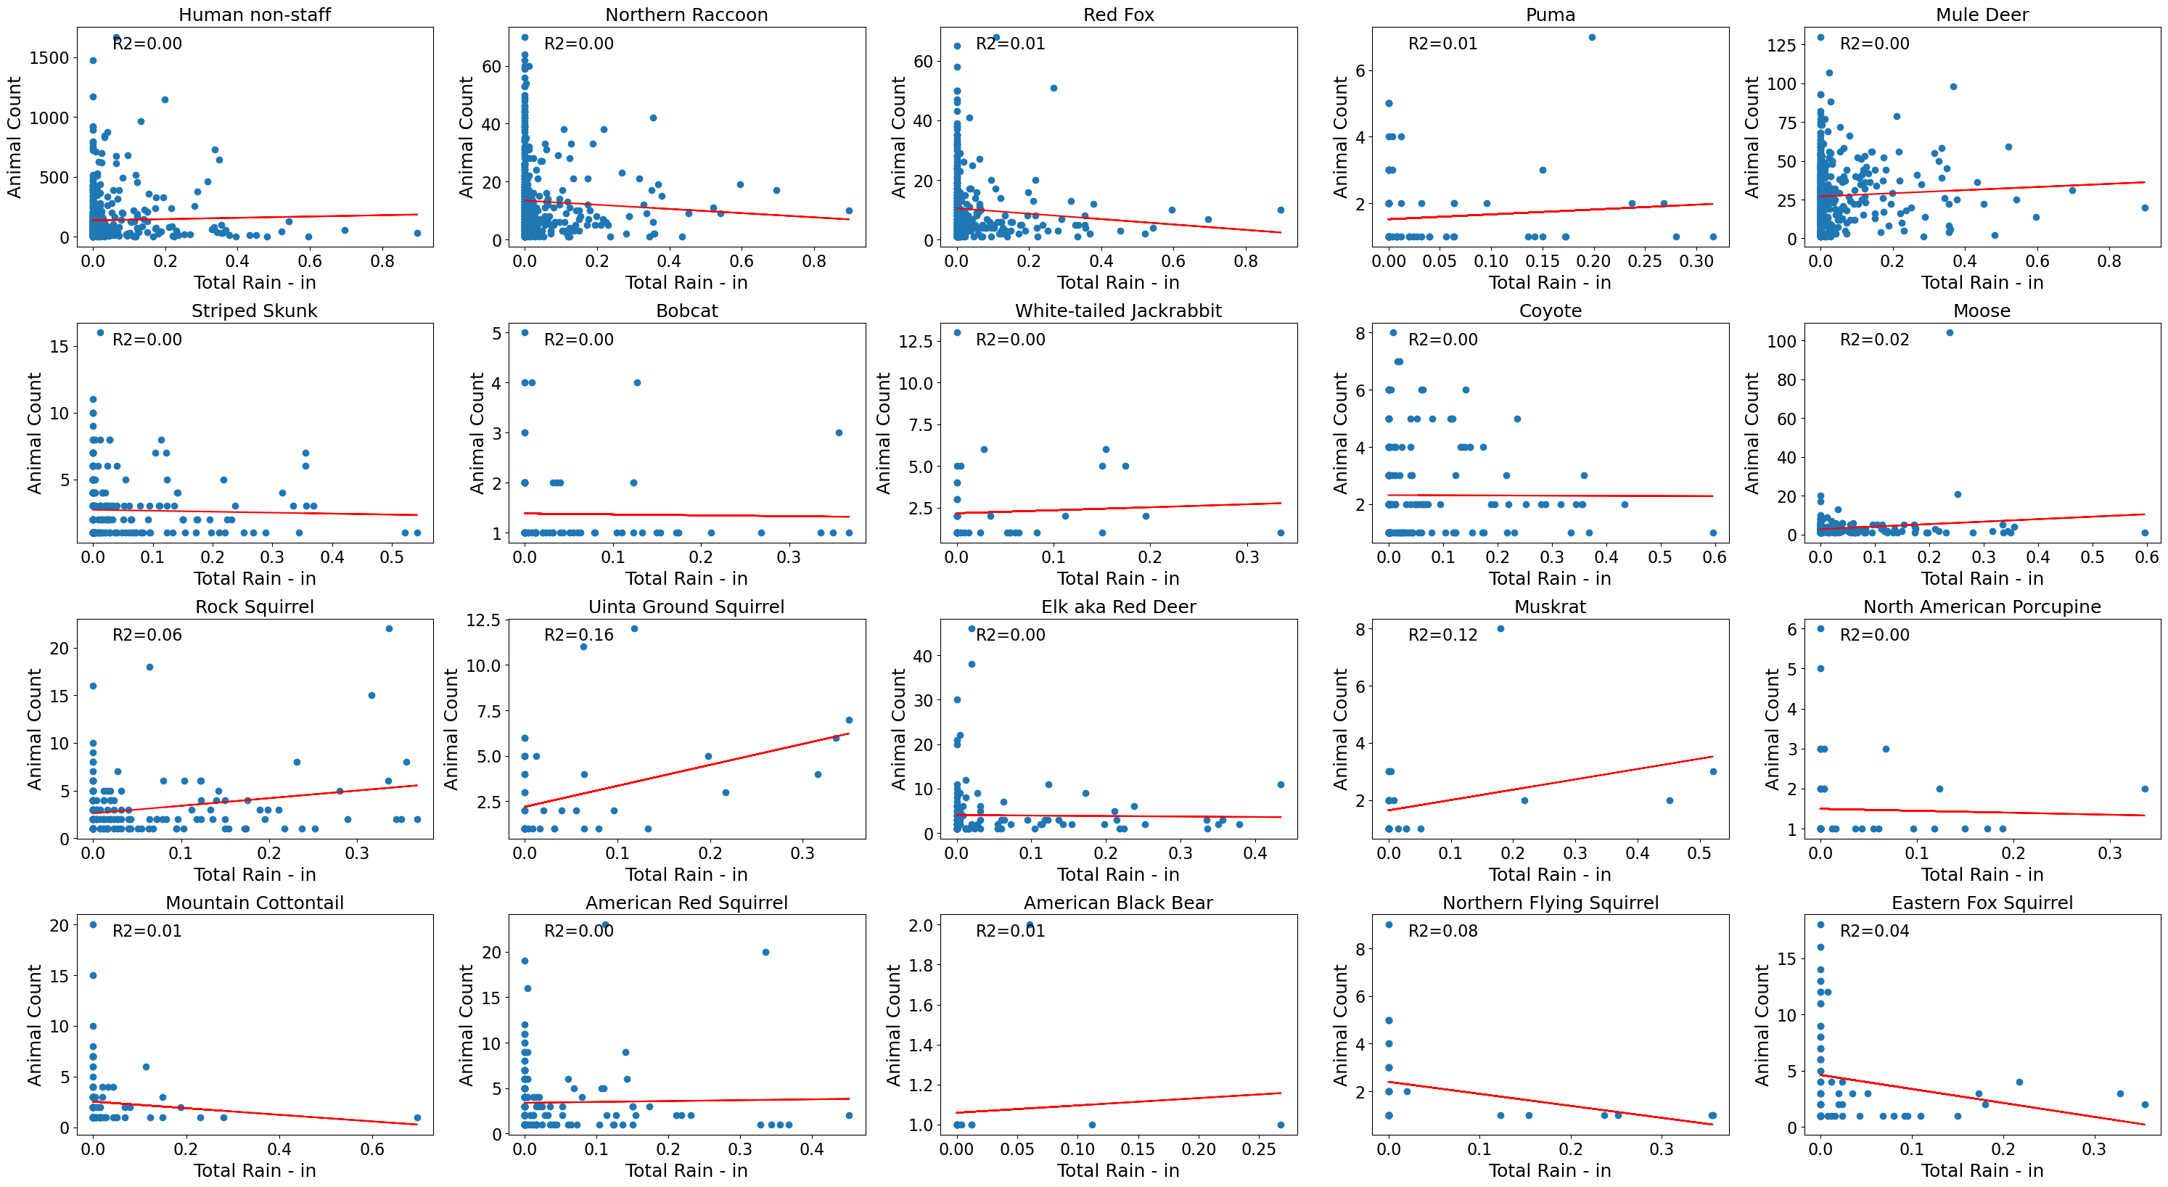
Rain vs Wildlife
Key Conclusions
Overall
Rain has minimal impact to animal counts
Humans
Less humans when there is more rain reported
Muskrat
Increase in muskrat observations when rain totals increase
Uintah Ground Squirrel
Highest R² of rain observations

Slide 13
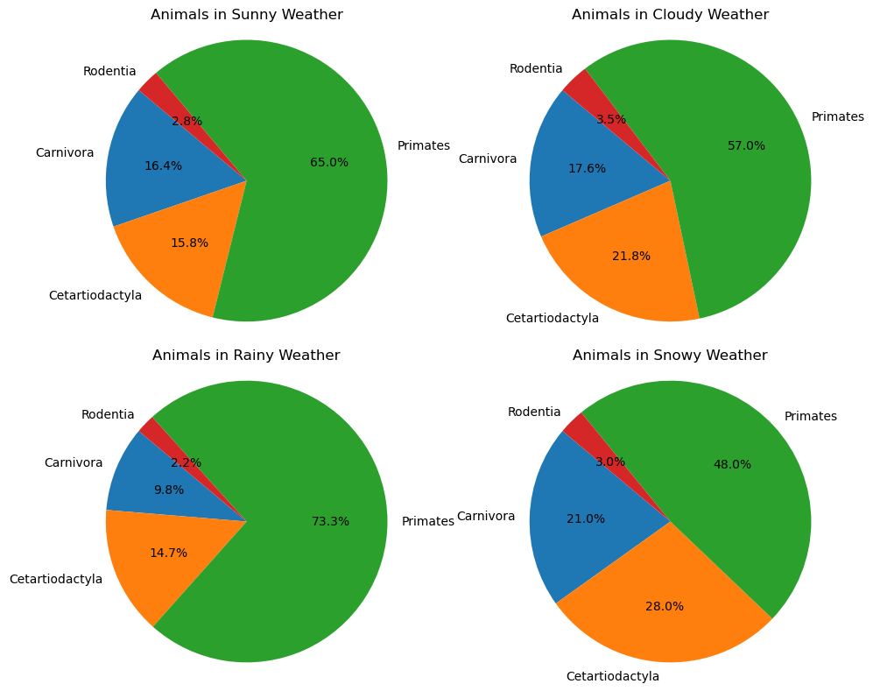
Do Animal Groups Prefer Specific Weather Types?
Primates – Humans
Cetartiodactyla – Elk, Moose, Mule Deer
Carnivora – Black Bear, Coyote, Bobcat, Puma, Red Fox
Rodentia – Squirrel, Beaver, Muskrat, Porcupine

Slide 14
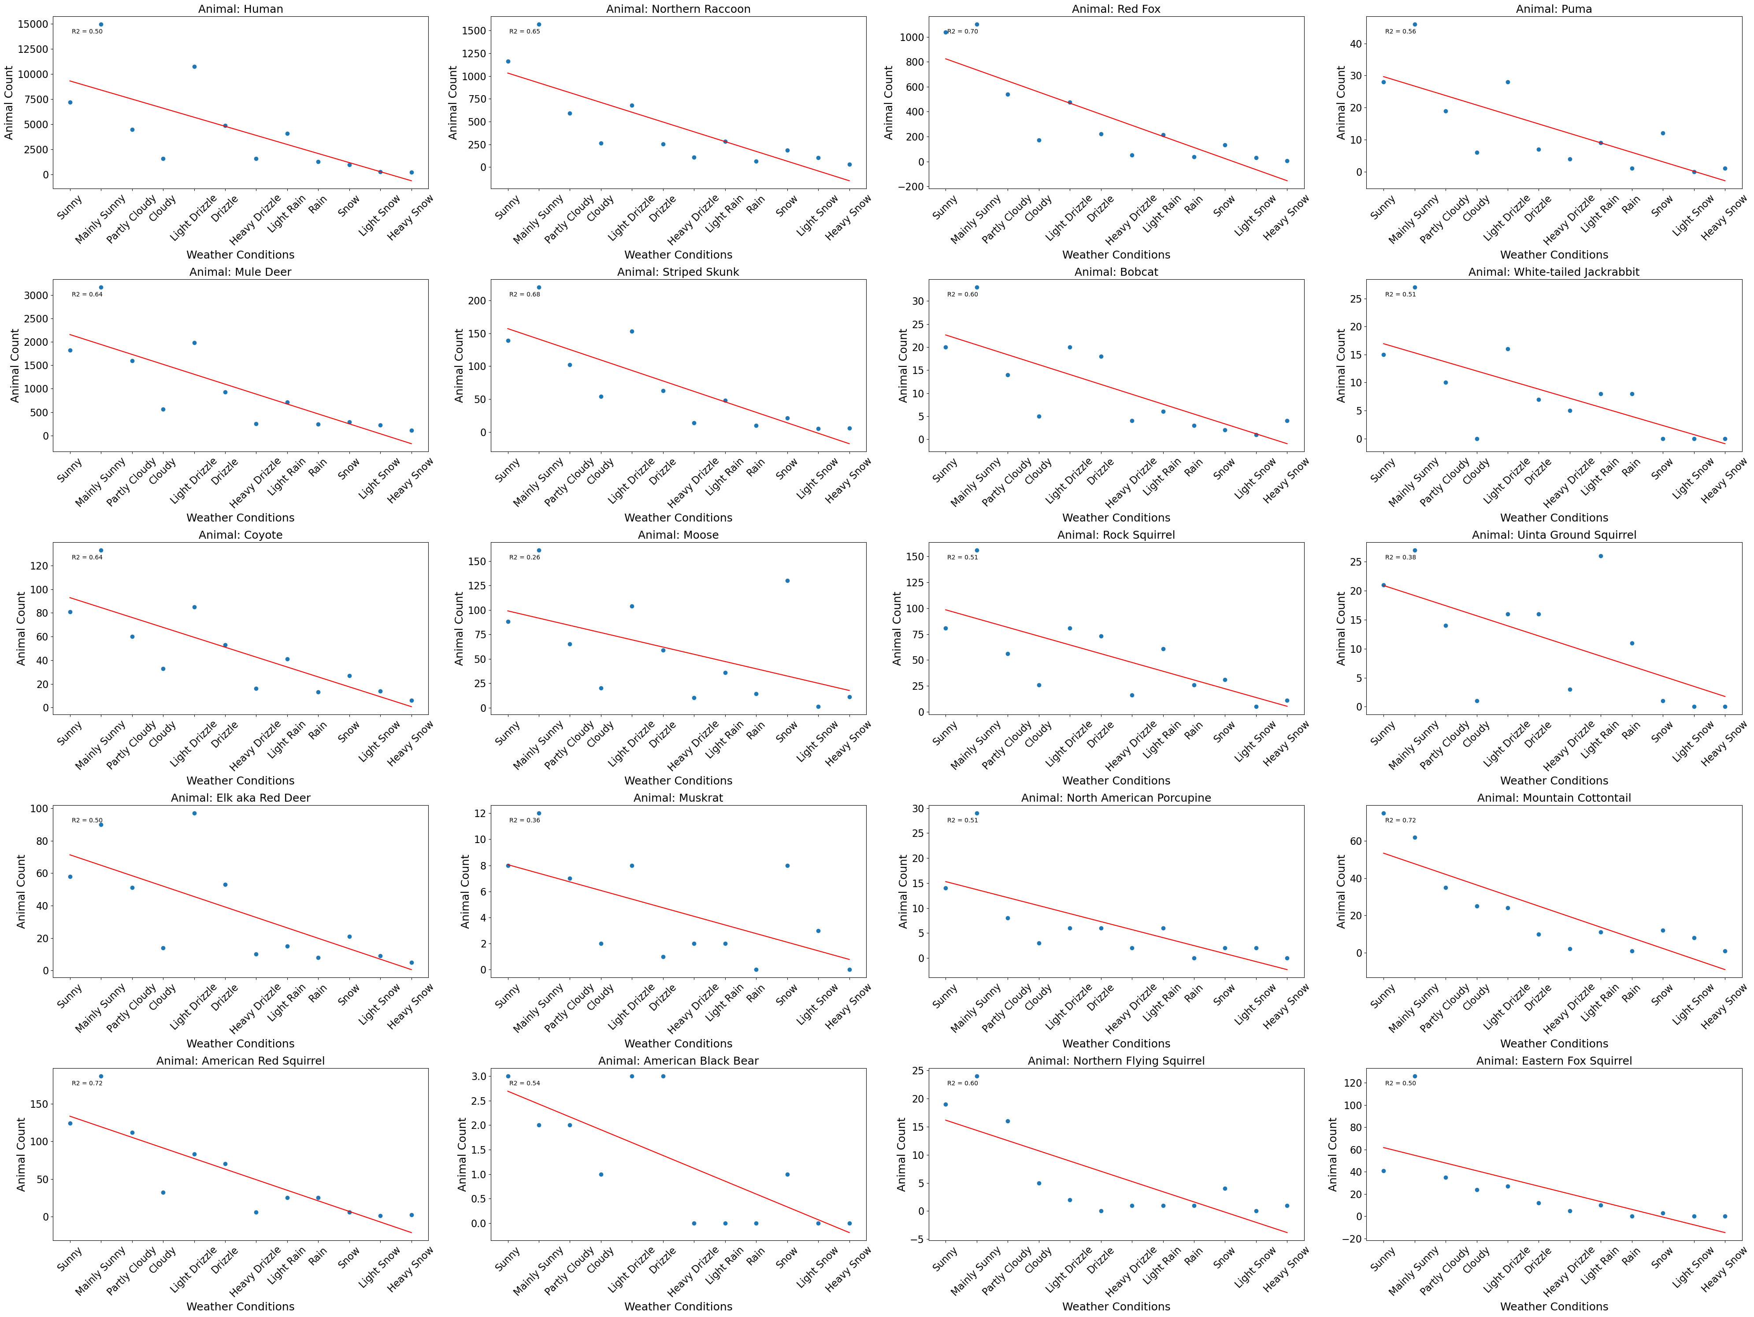
Weather vs Wildlife
Key Conclusions
All
As weather conditions worsen most animals take shelter
Muskrat
Had the lowest R² rating when weather conditions worsen
Moose
Higher observations were seen when the weather was classified as snowy

Slide 15
Conclusion
Urbanization
Weather
There was a clear indication that urbanization affected all animals to some degree
After discerning Moose and Elk were most negatively affected by urbanization, we found the top five station locations they were photographed. These locations could be studied further as potential wildlife protection zones.
We have found that temperature and rain both have impacts to certain species and their activity levels throughout the day.
Future work that could be done on this dataset is to find a better trend line than a linear one to better describe animal activity during the day. Also, it would be interesting to get a wildlife expert to look at the data and see if it matches what they would expect for each animal.

Slide 16
THANK YOU!
Wildlife Insights https://www.wildlifeinsights.org/
Historical Weather https://open-meteo.com/
Github
https://github.com/kwlayton1/Project1/tree/main

